Slide 1
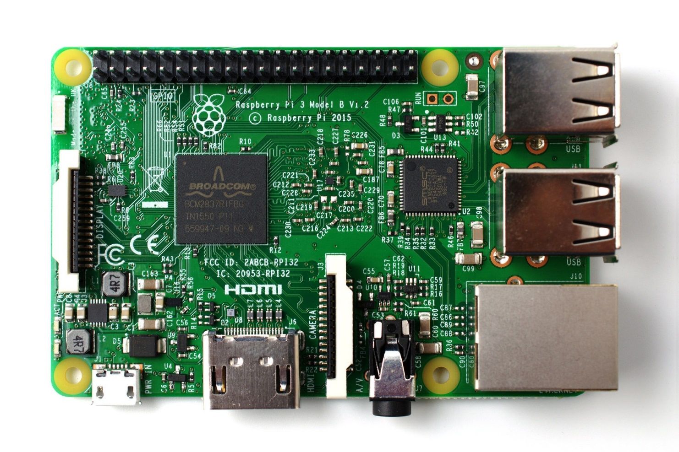
Getting Started with Raspberry Pi (RPi)
Creative Crew (12 Aug 2016)
By: Yeo Kheng Meng (yeokm1@gmail.com)
https://github.com/yeokm1/getting-started-with-rpi

Slide 2
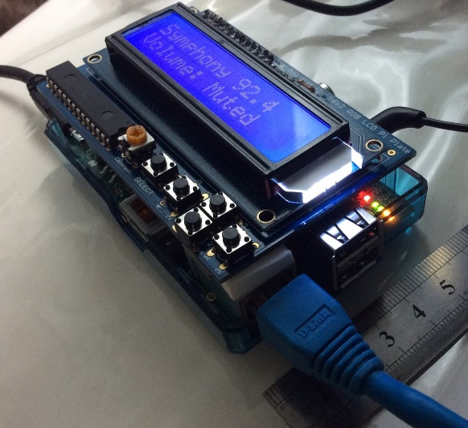
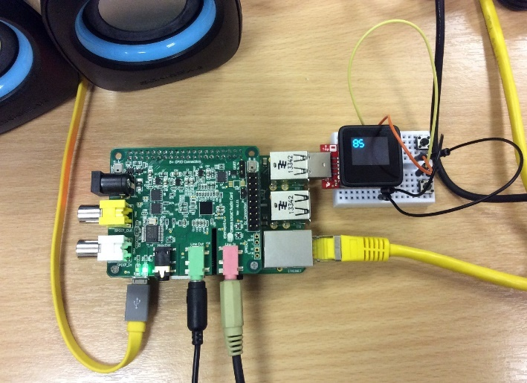
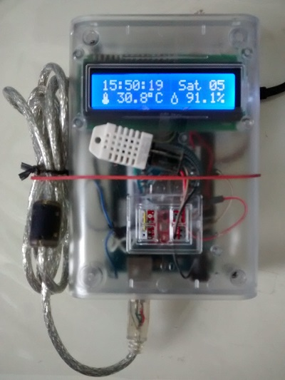
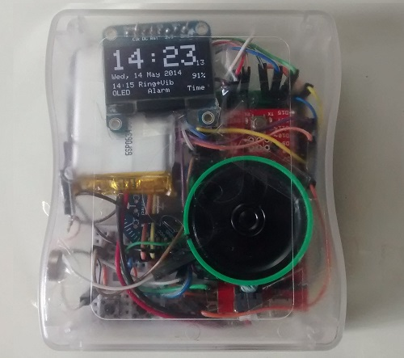
About me
Hardware Engineer at Algo Access
My Hardware projects with Arduino and Raspberry Pi

Slide 3
Who is this talk for?
Beginners to the world of hardware
People with Arduino experience

Slide 4

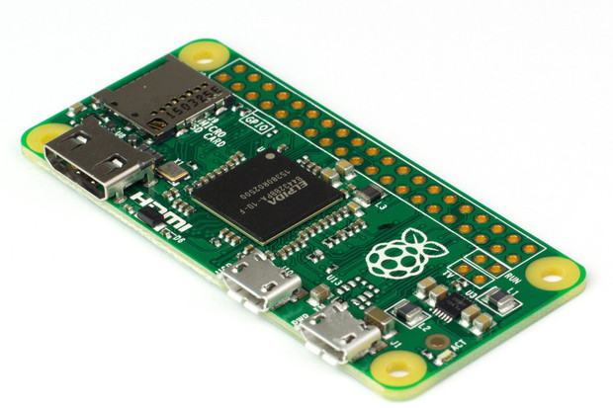
What is a Raspberry Pi (RPi)?
The Raspberry Pi is a series of credit card-sized single-board computers developed in the United Kingdom by the Raspberry Pi Foundationto promote the teaching of basic computer science in schools and developing countries
https://en.wikipedia.org/wiki/Raspberry_Pi

Slide 5

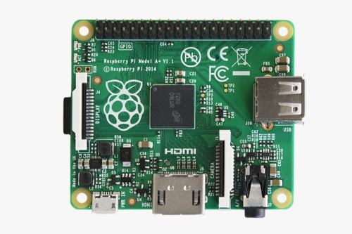
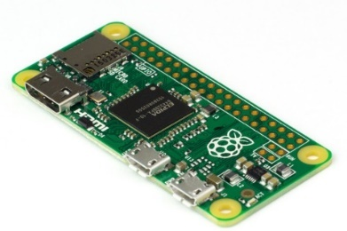
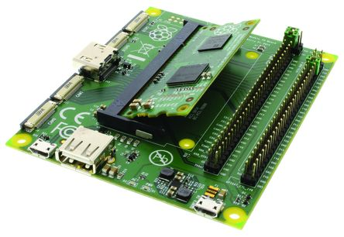
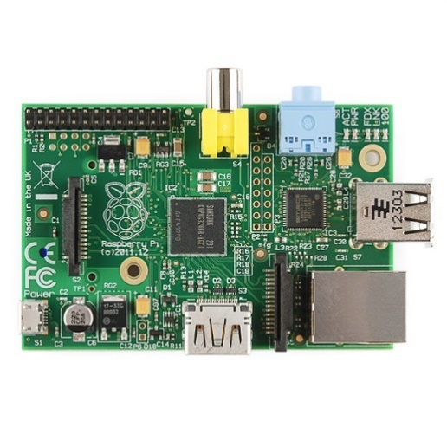
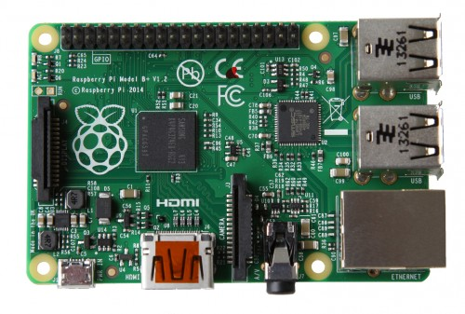
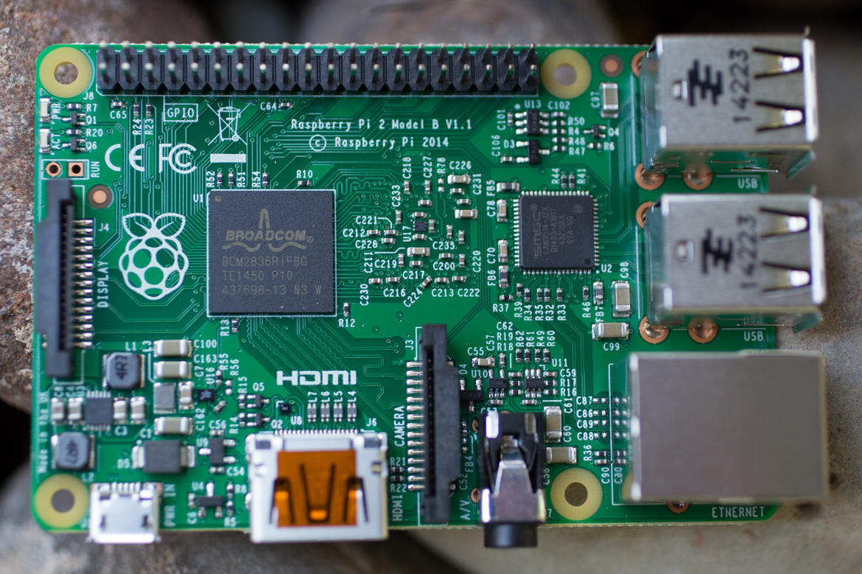
Types of Raspberry Pi
Special Mention
3 Model B (2016)
1.2Ghz quad-core ARMv8
1024MB RAM
4 USB ports
Ethernet port, Wifi, Bluetooth
Model A+ (2014)
700Mhz single-core ARMv6
256MB Ram
1 USB port
No Ethernet port
Zero (2015)
1Ghz single-core ARMv6
512MB RAM
1 USB OTG port
Micro-HDMI
Compute Module (2014)
700Mhz single-core ARMv6
512MB RAM
4GB onboard flash
SODIMM connector
Obsolete (Do not purchase unless you have special reasons)
Model B (2012)
Model B+ (2014)
2 Model B (2015)
700Mhz single-core ARMv6
256MB RAM
2 USB ports
Ethernet port
700Mhz single-core ARMv6
512MB RAM
4 USB ports
Ethernet port
900Mhz quad-core ARMv7
1024MB Ram
4 USB ports
Ethernet port

Slide 6
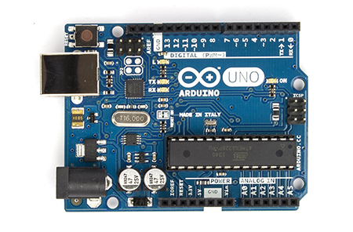
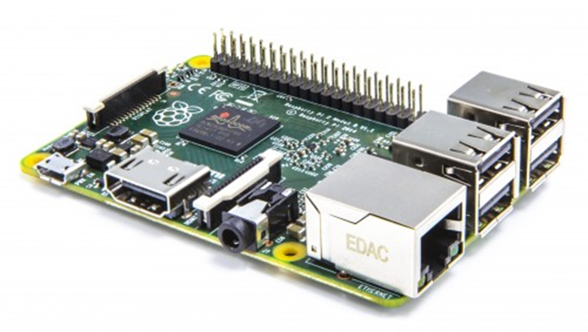
Arduino vs Raspberry Pi
Specs | Arduino Uno | Raspberry Pi 3 Model B
CPU type | Microcontroller | Microprocessor
Operating System | None | Linux (usually Raspbian) or Win 10
Speed | 16 Mhz | 1.2Ghz
RAM | 2KB | 1GB
GPU/Display | None | VideoCore IV GPU
Disk | 32KB | Depends on SD card
GPIO pins | 14 digital pins (includes 6 analog) | 26 digital pins
Other connectivity | None | USB, Ethernet, HDMI, audio
Power consumption | 0.25W | 6W

Slide 7
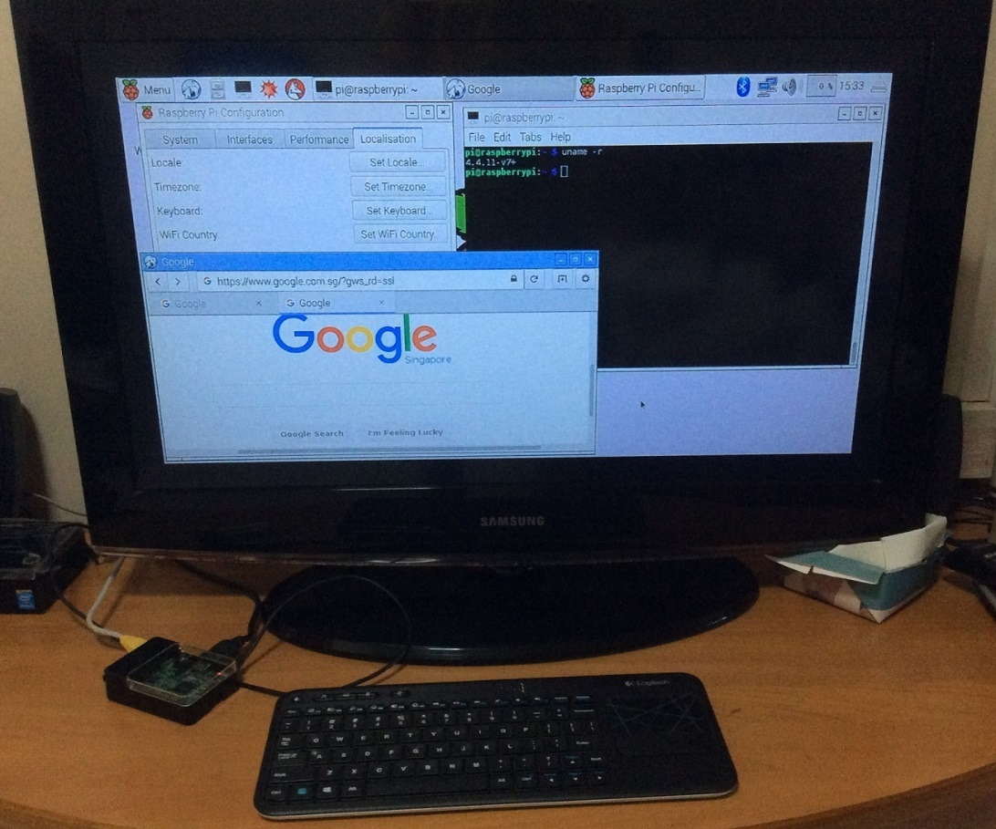
Minimum to get started
Raspberry Pi 3
HDMI monitor
USB Keyboard
USB Mouse
2.5 Amp USB Power Adapter
Micro-USB cable
8GB Micro-SD card
Computer to load initial card image

Slide 8
Step 1: Download SD card image
Download *.img files from
https://www.raspberrypi.org/downloads/
https://www.raspberrypi.org/downloads/raspbian/
Beginners should pick Raspbian Jessie

Slide 9
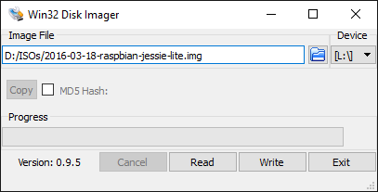
Step 2: Write image to SD card
Windows computer
https://sourceforge.net/projects/win32diskimager/
Mac and Linux computer
Get drive number of SD card
sudo fdisk –l
Write disk image to drive number N
sudo dd if=path_of_your_image.img of=/dev/rdiskN bs=1m

Slide 10
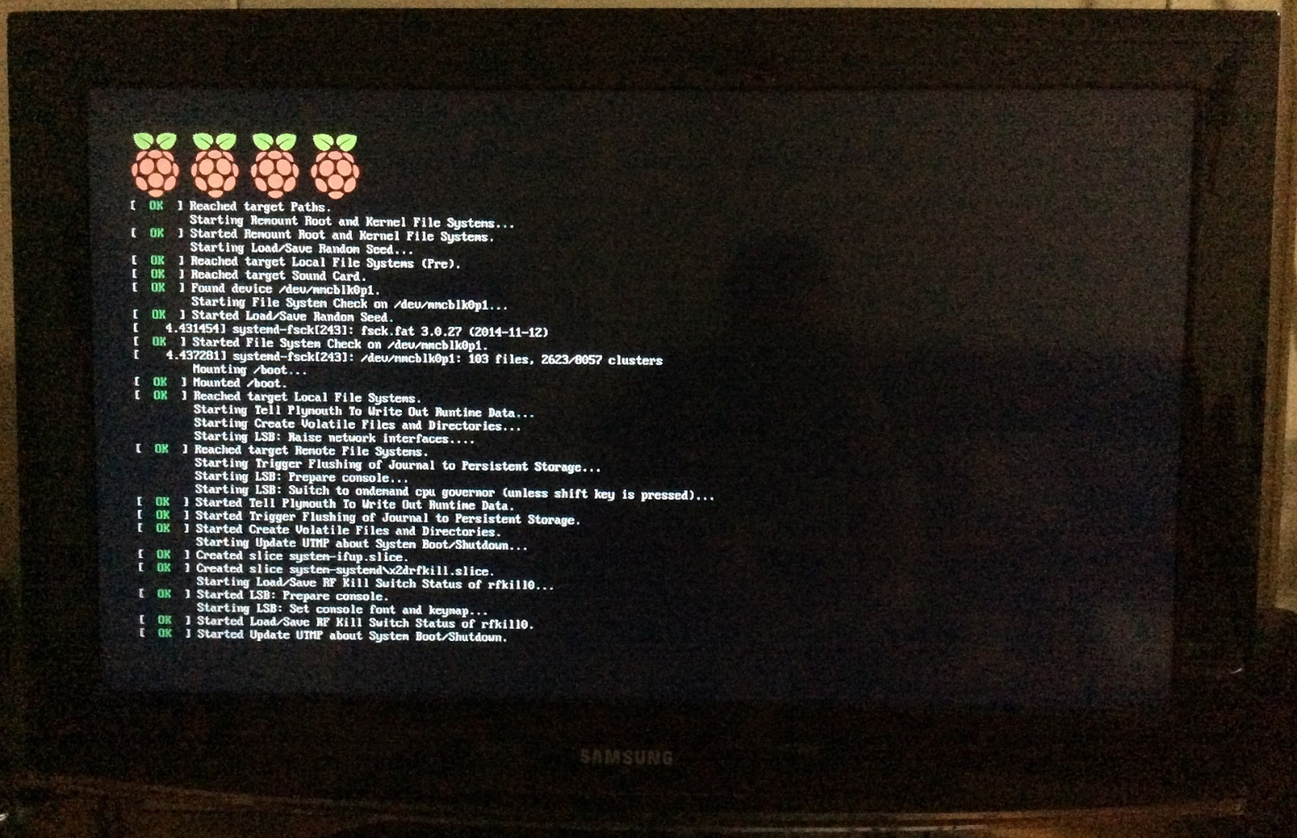
Step 3: Boot Raspberry Pi from SD card
Might take a few minutes for the first time

Slide 11
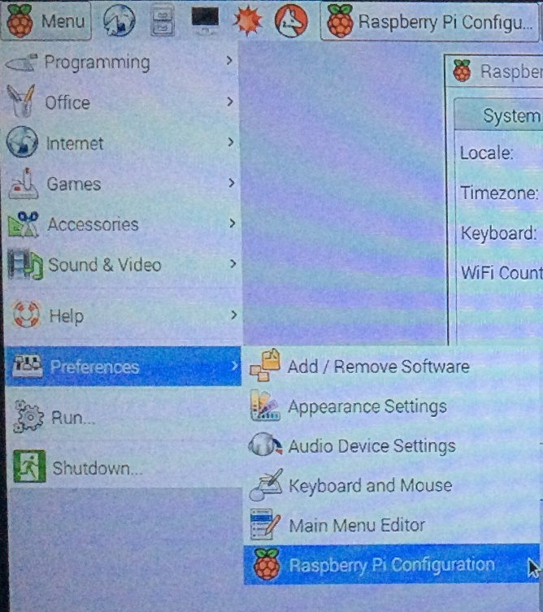
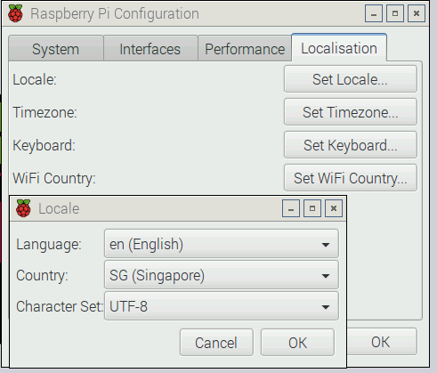
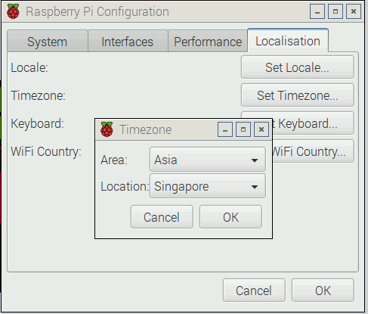
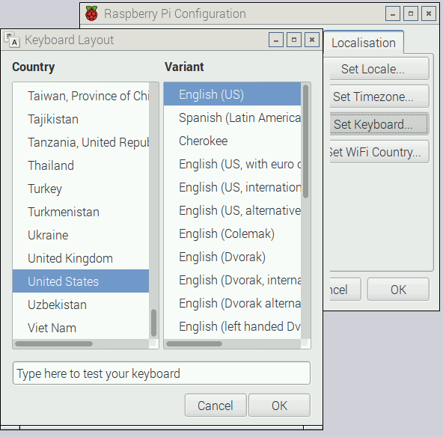
Step 4: Initial Configuration
Set locale to Singapore
Set keyboard layout to English (US)
Configure locale and time zone

Slide 12
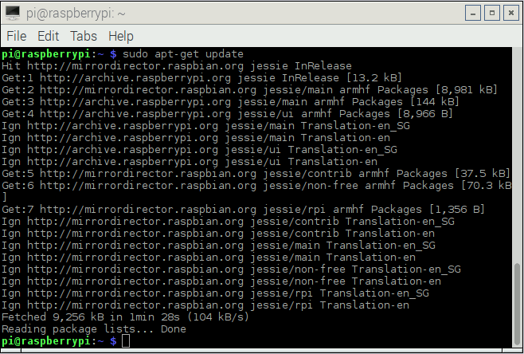
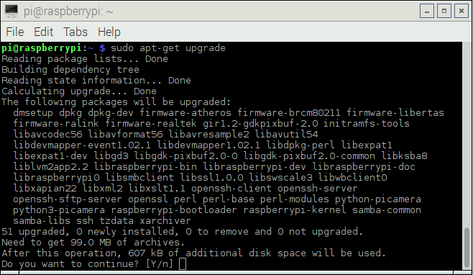
Step 5: Do a system update
Connect to the Internet
Open the terminal
Look for new system updates
sudo apt-get update
Download and install latest updates
sudo apt-get upgrade
Recommend to reboot after that

Slide 13
Available Applications
Web Browser: Epiphany
Office Applications: Libreoffice
Media Player: VLC
Run: sudo apt-get install vlc

Slide 14
Raspbian default username/password
Username: pi
Password: raspberry

Slide 15
File System Directory layout
/home/pi or “~”
Your “Home” directory
Removable Drives at
/media/pi/….

Slide 16
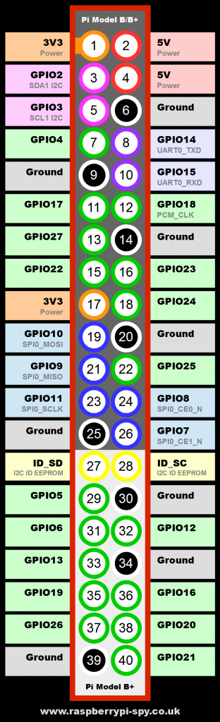
Header pins
26 Digital-only General Purpose Input Output pins
3.3V logic levels
Arduino uses 5V

Slide 17
Using the GPIO pins
Python programming language
LED
Button

Slide 18
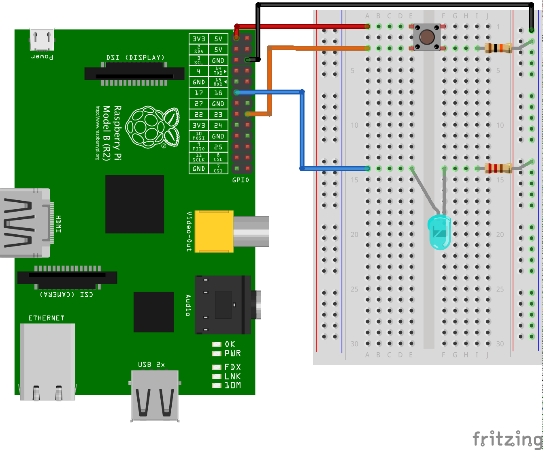
LED and Button Connection
Parts
Breadboard
Button
1x 10K ohm pull-down resistor
Button
1x 220 ohm resistor

Slide 19
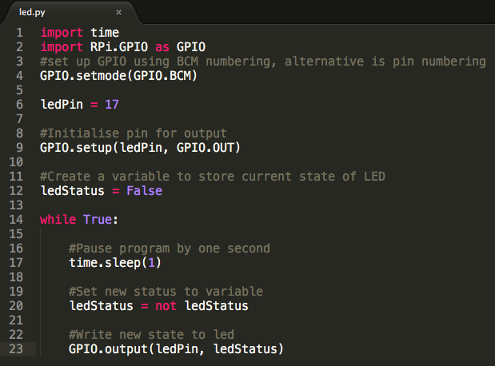
LED Blinky
Blink LED at 1 second intervals using Python
python led.py

Slide 20
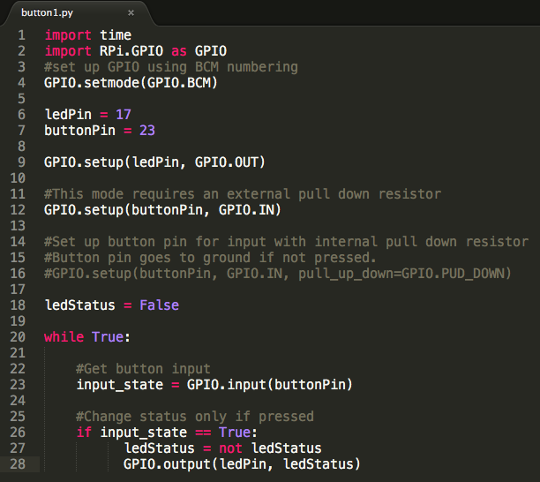
LED and button code 1
Button press supposed to toggle LED status
python button1.py

Slide 21
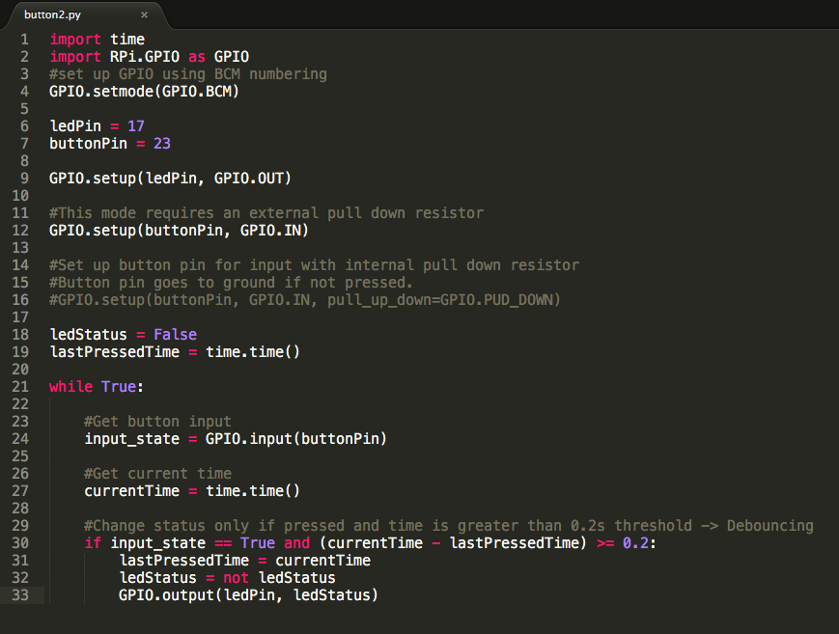
LED and button code 2 (Debouncing)
Button press now toggles LED correctly
python button2.py
Observe CPU usage: “ps aux | grep python” or Task Manager

Slide 22
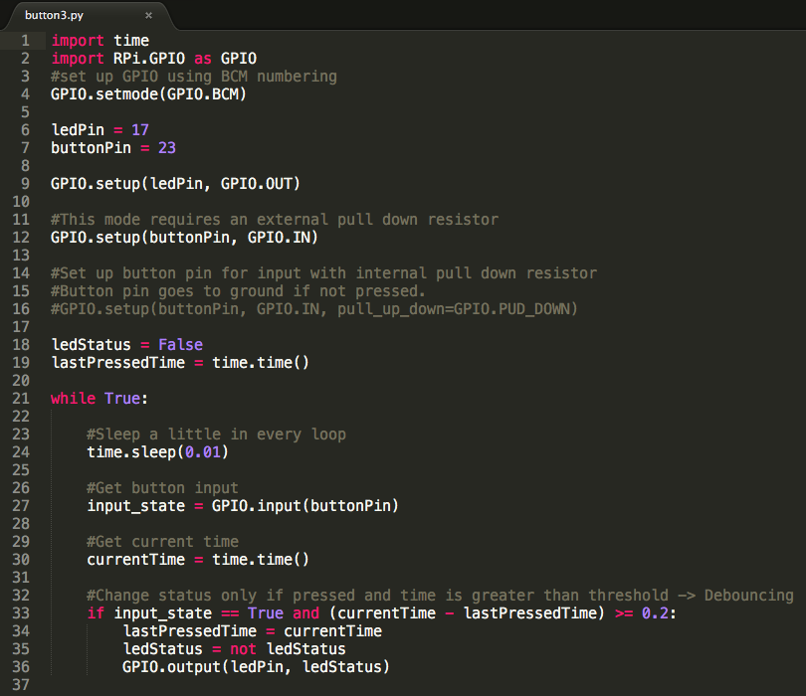
LED and button code 3
Toggle LED without sucking CPU resources by sleeping a little in the loop
python button3.py
Observe CPU usage: “ps aux | grep python” or Task Manager

Slide 23
Some warnings
RPi does not keep time on poweroff
No onboard battery and Real-Time-Clock (RTC) chip
It can sync time when connected to network
Do not connect current-heavy USB devices
600mA for all USB ports default. Can increase to 1.2A
In: /boot/config.txt Add: max_usb_current=1
2.5A resettable polyfuse
Use powered USB-hub if needed

Slide 24
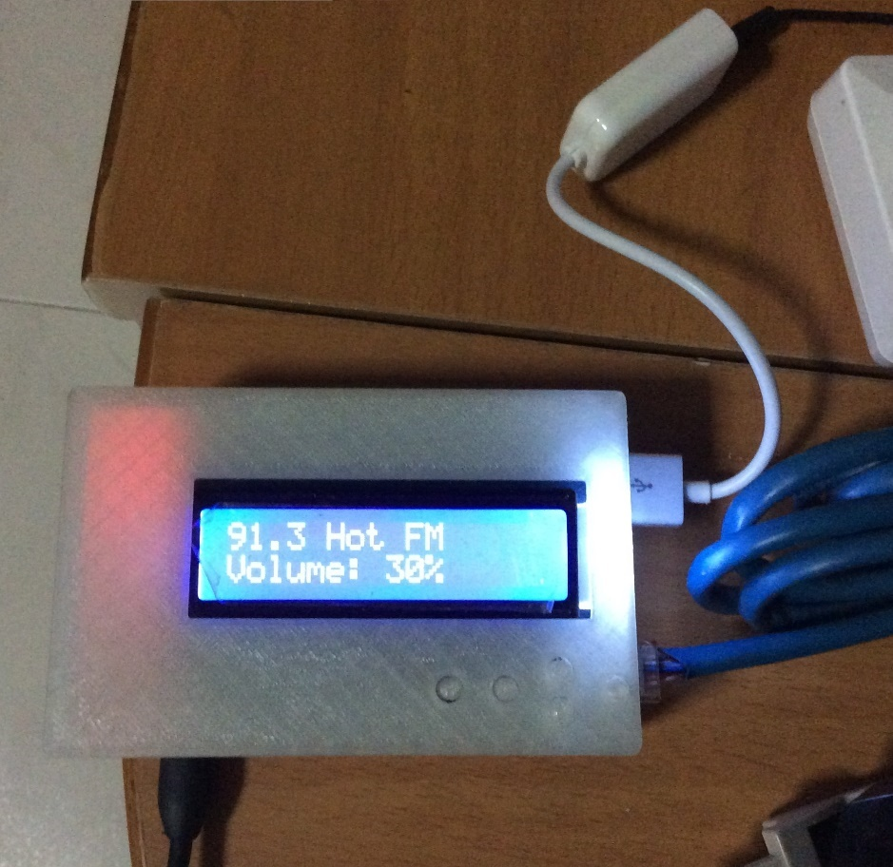

My internet radio streamer project
https://github.com/yeokm1/pi-radio

Slide 25
Q&A

